Slide 1
Database ERD Purpose
Winston Narada Kusumahadi
Aldi Putra
Hansel Zorya Ashero
Notes:
Winston

Slide 2
Why We Choose Anime?
A lot of people are craving for anime movies and/or series
Entertainment is everlasting (Everyone wants it)
Entertainment is a factor for innovation of technology as it generates new imaginations that may enlighten people to improve the quality of life.
Supporting Evidence:
There are between 90 and 100 million anime viewers worldwide. According to estimates, between 40% and 60% of people worldwide engage in passive or active viewing of anime. Since this range excludes those who watch anime through subscription services or on physical media like DVDs and Blu-ray, it is expected that the overall number is greater.
Notes:
Hansel

Slide 3
Why is DB / RDBMS Necessary?
The ability to connect data from different tables to create useful information is very helpful. It helps organizations of all sizes and industries decipher relationships between different sets of data, from various departments, to create meaningful insights.
Notes:
Aldi

Slide 4
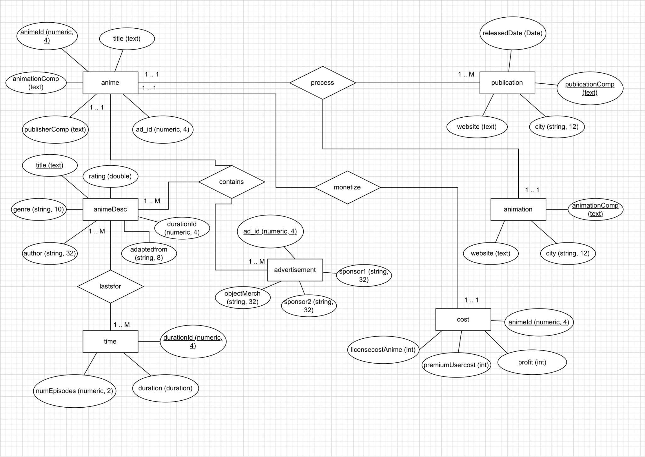
Chen ERD
Notes:
winston

Slide 5
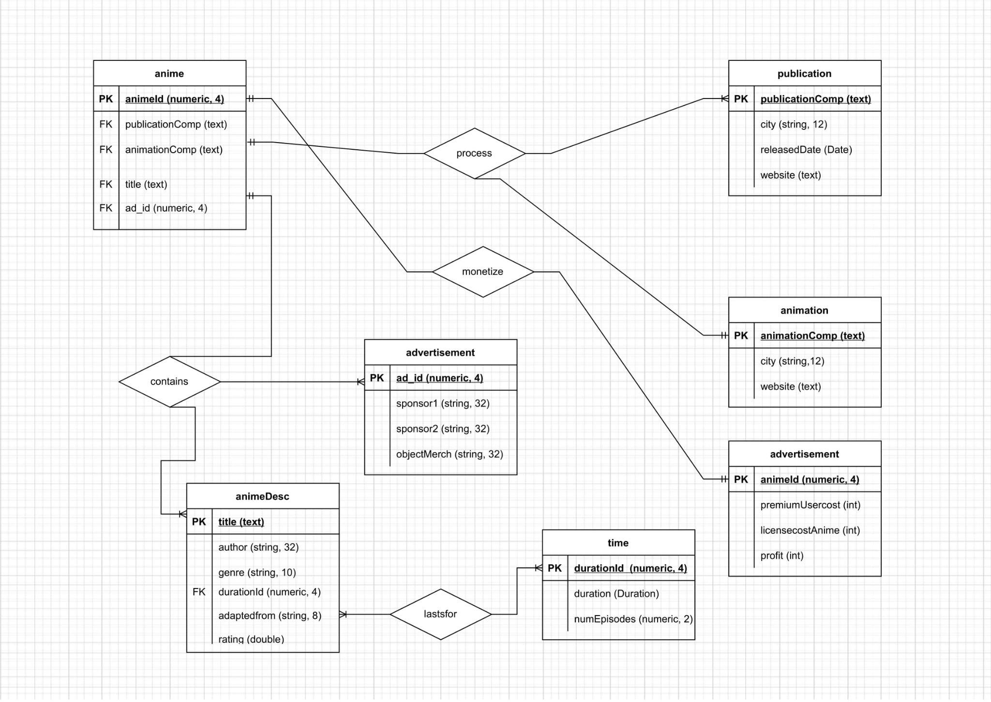
Crow’s Foot ERD
Notes:
winston

Slide 6
How Can We Monetize it?
Target market = Anime lovers (they seeks references to watch anime), companies that wants to produce to new anime movies/series (They need references for finding animation and publication companies),
Cost to employ a website = total licensing cost per year
Profit target: net 20% of total income
Plans for income : Yearly subscription (unlimited access on the anime infos)
Limited access for free users are the animation and publication company list, including the list of sponsors that support each anime.
Notes:
Aldi

Slide 7
Any other alternatives from using MySQL?
Oracle
MariaDB
MongoDB
Notes:
Hansel

Slide 8


